Slide 1

HOW TO MASTER
The Art of Selling
Based on Tom Hopkins' bestselling framework
Sales Training Seminar

Slide 2
"What separates the top 5% of earners from everyone else in any field?"

Slide 3
Why Sales?

Slide 4
Selfless Reasons to be Salesman
- Help people make decisions
You are the economy
Match people with solutions they didn’t know about
Give people permission to have what they want
Source of trust in a low trust world

Slide 5

Know Your Product
Better Than Any Lead Ever Could
▸ You can't prospect with strength unless you know your offering
Product knowledge is the foundation. Without it you can't prospect, present, or close effectively.
▸ Know your offering's benefits AND its limitations
Every product has a sweet spot. Trying to sell it outside those limits gets you exposed fast.
▸ Become the doctor and diagnose before you prescribe
Ask questions. Gather data. Only when you've zeroed in do you present the solution.
▸ Know the competition, and what qualifications buyers need
Expertise lets you decide who should — and shouldn't — become your client.

Slide 6




Create the Selling Climate
Sell the People Who Can Buy
Don't Sell Logic — Arouse Emotions
Never spend hours with someone who can't say yes. Find the real decision-maker — the gnome behind the committee — and work with them. In family sales, identify which partner holds the veto.
Logic is a gun without a trigger. Buyers purchase on emotion — pride of ownership, security, status, family love — then justify with facts. Hit the emotional hot buttons first.
Replace Rejection Words with Go-Ahead Terms
The Senses That Sell Emotions
"Cost" → "Total Investment" | "Monthly Payment" → "Monthly Amount" | "Contract" → "Agreement" | "Buy" → "Own". Words create images. Negative images destroy sales in seconds.
Everything you say paints a picture. One negative image can wipe out ten positives. Watch your tone, grooming, and body language — prospects react emotionally before they think logically.

Slide 7
If they say it, it's true. If you say it, they doubt you.
Rule #1: ASK QUESTIONS
Discovery Questions
Leading Questions
Open Questions – WWWWWH
Closed Questions
Alternative Option
"Would Tuesday or Thursday work better?“ - Offer two options
Porcupine
"Which color appeals to you most?“ – Answer with a Question
Involvement Question
"Where would you put this in your office?“ – Ownership
Who will be using this the most?
What feature is most critical for you?
Where do you see this evolving?
When would you like this implemented?
Why are you investing in this now?
How do you see it benefiting your team?
Tie downs
Can this person buy: budget, authority, timeline, need
Why do they want this? – emotion
What features matter most?
“Great idea, isn’t it?“
"Isn't it a great product?“
"Because it's the best value, isn't it, you'd want to move forward?"
In the Discovery phase, questions can be either open or closed as you are looking to better understand the prospects needs and/or wants.
Leading questions are almost always closed as they are engineered to give you an answer that will lead you to closing a sale.

Slide 8

Finding People to Sell
20
People. Belly to Belly. Every Day.
Never a shortage of work in sales. There is always more to do.
Champions always make one more call after a rejection, never end on a negative note.

Slide 9
Ratios
Knowing your ratios helps keep you on track and positive
01
Rejection Ratio
10 Rejections : 1 Sale of $500, each rejection you make $50
02
Referral Ratio
How many referrals per sale?
03
Hours to Dollars Ratio
Honest reflection twice a year
04
Prospecting Ratios
Prospect calls made per Hour of Prospecting + Prospecting Calls to Appointments Set
05
Lag Ratios
Help to determine the time passed between Prospecting and making a Sale

Slide 10
Non-Referral Prospecting
1
The Itch Cycle
2
Orphan Adoption
3
Local Newspapers
Or Social Media
Every product has a natural replacement cycle. Know when your clients are ready to itch again and be there first.
Former clients of salespeople who left your company. They have no rep — adopt them and serve them.
Birth, marriage, promotion, and business announcements are prospecting gold. Congratulate and connect.
4
Claim-Staking
5
Swap Meets / Leads Clubs
6
Community Involvement
Identify a neighborhood or niche and become the recognized expert. Consistency in one area beats scattered effort.
Structured groups that trade non-competitive leads. One good relationship in a club can fuel months of pipeline.
Volunteer, sponsor, participate. You become a known trusted face — the exact person people want to buy from.

Slide 11

Referral Prospecting
The easiest close is a warm introduction.
1 referral/sale
2 referrals/sale
3 referrals/sale
4+ referrals/sale
Top 50%
Top 20%
Top 10%
Top 5%
The Card Referral System — 6 Steps
1. Isolate faces — bring small groups to mind (their bowling team, troop, etc.)
2. Get full names and correct spelling
3. Ask qualifying questions — why did that person come to mind?
4. Get contact info or look it up together
5. Ask them to call — give you permission to use their name if not
6. Promise highest-quality service and follow through

Slide 12
Qualifying Your Leads
You can't make money trying to sell the wrong people.
Pre-Qualifying
Qualifying
▸ Identify the true decision-maker before investing time
▸ Six-step sequence: who, what, when, why, how, how much
▸ In committee sales — find the influential 'gnome' behind the title
▸ Use the Triplicate of Choice to focus options (A, B, or C?)
▸ In family sales — determine who holds the real veto
▸ Avoid the Uh-Price trap — qualify budget early without triggering fear
▸ Never try to close people who can't say yes
▸ Lots of appointments + few sales = qualification problem, not closing

Slide 13
Triplicate of Choice for Money
The best single strategy for eliminating price as an objection.
The 5-Step Formula
Most people interested in acquiring this are prepared to invest [HIGH]. A fortunate few can invest between [HIGHER] and [HIGHEST]. And then there are those on a limited or fixed budget who — with the high cost of everything today — can't go higher than [YOUR PRICE]. May I ask, which of these categories does your company fit into most comfortably?
Step 1
Quote 20% ABOVE your actual investment (the anchor)
“
Step 2
Quote a range of 50-100% above your price (makes the anchor feel reasonable)
Step 3
State your ACTUAL price last — as the floor / budget option
”
— Tom Hopkins, Ch. 14
Step 4
Ask: "Which category does your company fit into most comfortably?"
START USING THIS TODAY
Step 5
Whatever they pick, reply: "Great news — the model that meets all your needs is only [your price]" — which is always at or below what they stated
You win no matter which category they pick — your price always lands at or below what they said they could spend.

Slide 14
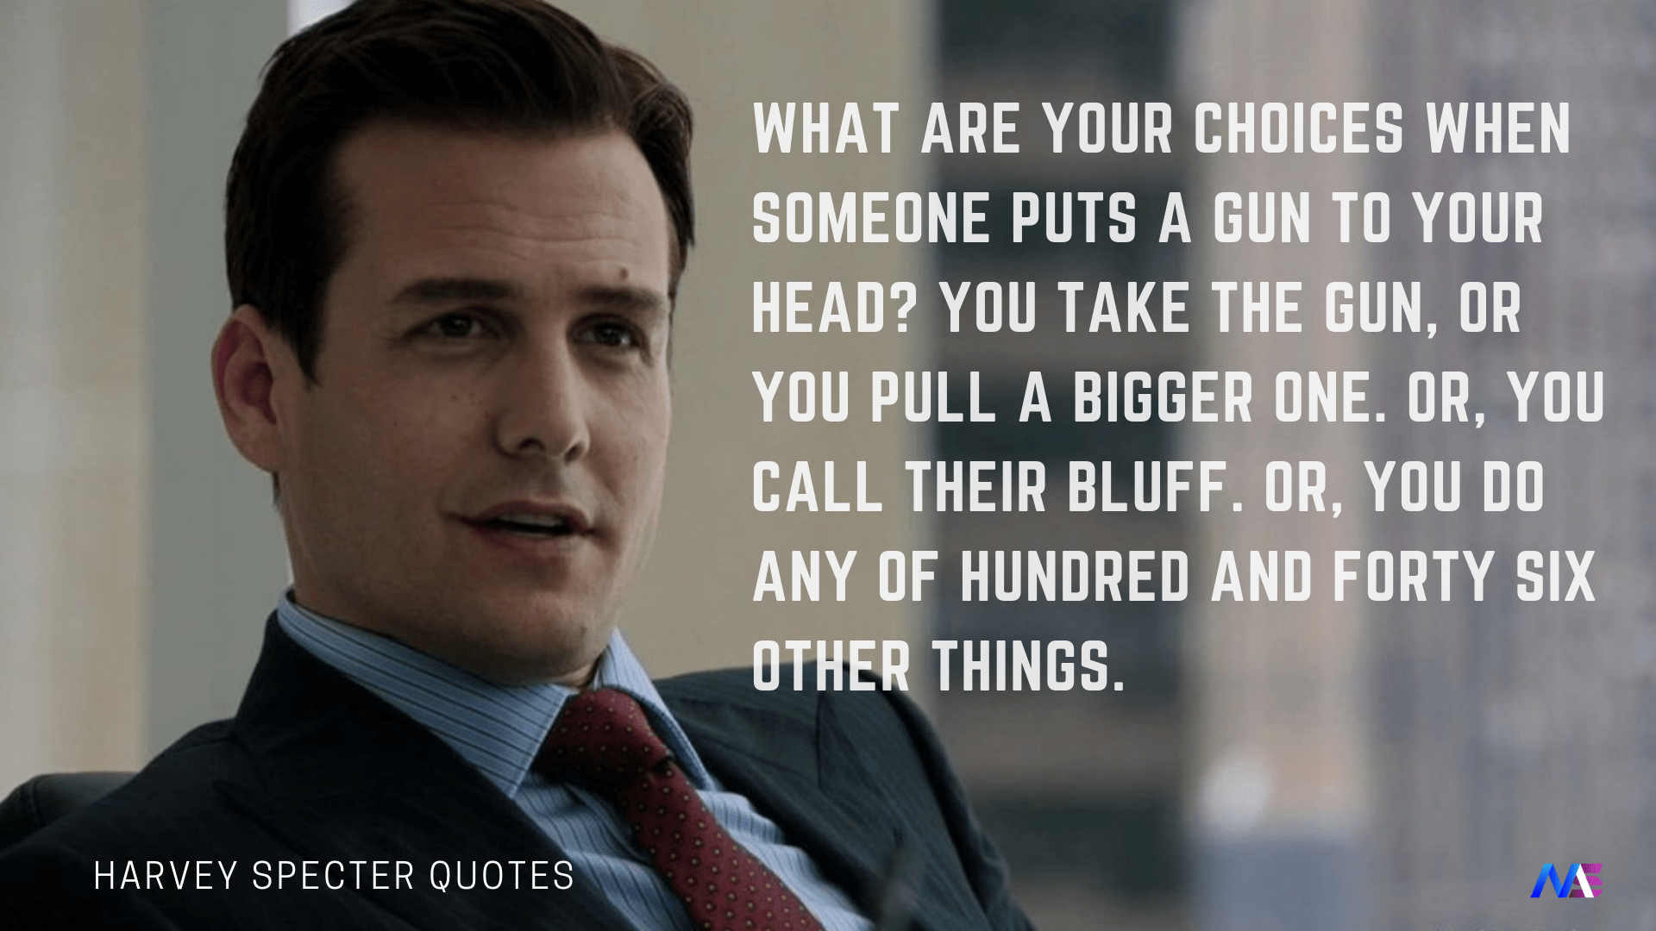
Overcoming Objections
Objections
How to Handle them
- Learn to love them
Objections are a part of every sale
Rungs on a ladder
Minor vs Major
Reveal where their interest lie
Don’t argue
Don’t attack them when you overcome the objection
Do lead them to the answer of their own objection
The 6-Step Process
Hear them out — never interrupt, let them finish completely
Cushion it — acknowledge without agreeing ("That's a fair point…")
Question it — isolate and clarify ("Is that your only concern?")
Answer it — give a concise, confident response
Confirm the answer — "Does that make sense?" / "Does that address your concern?"
Change direction — redirect toward the close immediately after

Slide 15
Rejections
Rejections
How to Handle them
Part of Sales
Know your Ratio
Conditions: Valid reason to not close on deal
Should be handled in timely manner
Can be used to create future business
Handle with grace and respect

Slide 16
Learn to Love No
The Five Attitudes Toward Rejection
01
A Learning Experience
Don't ask what you did wrong — ask what lesson you just paid for
02
Course Correction
Rejection is negative feedback that steers you back toward the target. Like a missile — adjust and keep going.
03
A Sense of Humor
The disaster you can't laugh at today is the story you'll kill with in three weeks. Laugh sooner.
04
Practice Opportunity
Every no is a free practice session. Perfect your technique — perfection compounds into sales.
05
It's the Game
Selling is a percentage game. The more people you see, the more yeses emerge. Champions always make one more call after a rejection.

Slide 17

Closing Skills
The 14 Most Important Words in Closing:
If I can show you... would you be willing to move forward today?
Test Closes Early
Use minor agreements throughout the presentation to gauge buy-in: That makes sense, does it not? Let them say yes many times before the big ask.
Close with Empathy
Feel what they feel. The close is not a conquest — it's guiding them to a decision that genuinely helps them.
Close Through Their Eyes
What does owning this look like for them? Paint the picture from their perspective, not yours.
When & Where to Close
Close when emotional momentum is highest. Anywhere they're comfortable — their home, your showroom, a coffee meeting.

Slide 18

The Power of Thank-You Notes
Most people receive almost none. One thank-you note makes you unforgettable.
When a client's secretary reads your note, she walks in and says: "We got a really nice thank-you note. Do you remember this person?" And the sale is half-made again.
Send Thank-You Notes When:
After any contact Any conversation where your product or service comes up, however briefly.
After every visit Recontact — even if they didn't buy. Especially if they didn't buy.
After referrals Thank the person who gave you the lead — and then give them the outcome.
After a sale Reinforce their decision. Buyer's remorse is real; a warm note dissolves it.
Cold encounters Met someone at a car wash? Hand-write Thank You on your business card and follow up.

Slide 19
Common Mistakes
Talking more than you listen
Fear of rejection
Selling to unqualified prospects
Poor allocation of time
Giving up after objections
Neglecting to follow up
Talking in “sales speak”
Performing instead of connecting
Losing control or interest

Slide 20
The Creed of the Champion
1. I never see failure as failure, but only as a learning experience.
2. I never see failure as failure, but only as the feedback I need to change course.
3. I never see failure as failure, but only as the chance to develop my sense of humor.
4. I never see failure as failure, but only as the opportunity to practice and perfect.
5. I never see failure as failure, but only as the game I must play to win.
— Tom Hopkins, How to Master the Art of Selling

